Slide 1
Web Service

Slide 2

Agenda
Web Evolution
Why Web Services?
What is Web Services?
Where is Web Services Going?
Web Services Architecture
Constructing Software In a Connected World
Web Services Standards

Slide 3
Web Evolution

Slide 4

Web
World Wide Web (Web 1.0)
Social Web (Web 2.0)
Semantic Web (Web 3.0)
  Web Serivces
  Web Science

Slide 5
Web 1.0
HTML(XHTML)
HTTP
Web Browsers
Notes:
Userid, coupon id , mouse hovers over a particular item

Slide 6
Social Web – Web 2.0
The term Web 2.0 was made popular by Tim O’Reilly:
http://www.oreillynet.com/pub/a/oreilly/tim/news/2005/09/30/what-is-web-20.html
http://en.wikipedia.org/wiki/Web_2.0
  “Web 2.0 … has … come to refer to what some people describe as a second phase of architecture and application development for the World Wide Web.”

Slide 7
Web 2.0 and social software
Web 2.0 focuses:
  The Web as a platform for social and collaborative exchange
  Reusable community contributions
  Subscriptions to information, news, data flows, services
  Mass-publishing using web-based social software

Slide 8
Web 2.0 and social software
http://en.wikipedia.org/wiki/Social_Software
  “Social Software lets people rendezvous, connect or collaborate by use of a computer network. It results in the creation of shared, interactive spaces…”
Social software for communication and collaboration:
  IM(Instant messaging ), IRC(Internet Relay Chat ), Forums, Blogs, Wikis, Social Network Services, Social Bookmarks, Podcasts, MMOGs(massively multiplayer online games) , RSS feeds …

Slide 9
Web 2.0 websites include some of the following features/techniques:
rich Internet application techniques, often Ajax-based
semantically valid XHTML and HTML markup
microformats extending pages with additional semantics
folksonomies (in the form of tags or tagclouds, for example)
Cascading Style Sheets to aid in the separation of presentation and content
REST and/or XML- and/or JSON-based APIs
syndication, aggregation and notification of data in RSS or Atom feeds
mashups, merging content from different sources, client- and server-side
weblog-publishing tools
wiki or forum software, etc., to support user-generated content

Slide 10
Semantic Web – Web 3.0
Tim Berners-Lee has a vision of a Semantic
Web which
  has machine-understandable semantics of
  information, and
  millions of small specialized reasoning services
  that provide support in automated task achievement based on the accessible information
Notes:
Client side provides basic piping and cross browser abstraction – server side provides browser-server coordination, ability to directly call java server-side apis

Slide 11
What is the Semantic Web?
“An extension of the current Web in which
information is given well-defined meaning,
better enabling computers and people to work
in cooperation.”
Notes:
Client side provides basic piping and cross browser abstraction – server side provides browser-server coordination, ability to directly call java server-side apis

Slide 12
Why web Service?
(From Business Points)

Slide 13
E-Commerce
buy
store
authorize
bank
get
ok
payment₁
bill₁
order₁
receipt₁
supplier1
Enactments with different life-cycles:E.g., one credit authorize for many orders

Slide 14


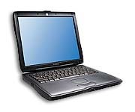

Telecom/Collaborative Services
Session
Coordinator
Pre-Pay
Presence
Server
Media
Server
(video)
Media
Server
(voice)
Emerging standards will enable
  Flexible, dynamic incorporation of features
  Convergence of telecom and web services
Bearer traffic vs. signaling/control traffic

Slide 15
E-Science
Controller
control and calibrations
Sea
Circulation
Atmospheric
Simulation
Waste
Transport
notifications and/or
experimental data
E.g., find best location for waste treatment plant
Possibly 100s of nodes, and running for weeks
Data size difference:
  Control and calibrations (small)
  Experimental data (large)
Provenance: need to access derivation history

Slide 16
Supply chain
Comprised of the interaction between parties that are required to produce products or services and deliver them to customers.
And itself applies to B2B and B2C.
E-business: the marriage of traditional supply chain management techniques with internet and web technologies.
  Consists of 3 major components
    E-commerce
      A piece of the overall e-business pizza
      Point-of-sale and direct transactions
    E-procurement
      Processes by which a manufacturer obtains products from suppliers
      Enormous in volume, quantity, and value.
      A target for aggregations of buyers and sellers – market place - to achieve great economies of scale.
    E-collaboration
      Share information among supply chain participants.
      A key area is collaborative planning to achieve a good decision.

Slide 17
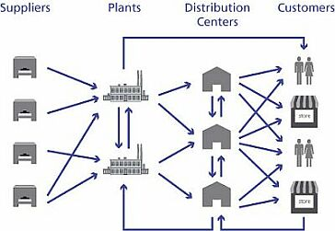
Supply Chain – an overview

Slide 18
Business Goals
Low cost
Streamlined
More efficient process
Monitor and track process execution
Detect and mange exception
In-time response, etc
Solution: IT

Slide 19
Business trends
Scale dimension
Time dimension
Intra-enterprise
Manual
Inter-enterprise
Electronic
Global interaction
Web

Slide 20
IT trends
Mainframe
Set of servers
Set of services

Slide 21
Problems
Different parties may have different:
  Operating system
  Interface
  Functionality
  Data format
  Security
  Infrastructure
  Interaction protocols
  Language, etc.
Automating supply chain implies bringing all of them together.
  Solution: Integration

Slide 22
B2B – an overview
Network
Enterprise 1
Enterprise 2
Data transformation
Conversation
Security and non-repudiation
Contract

Slide 23



B2B - an example before web service
web server
internal procurement
requests
internal infrastructure
B2B interactions occur by accessing Web pages, filling Web forms, or via email.
internal infrastructure
web server
internal infrastructure
warehouse

Slide 24

B2C Integration
Business-to-consumer (B2C) integration
It is the means to have human users connect to businesses in order to purchase or to sell goods or services.
And example is Amazon.com where customers can buy from a variety of goods, including kitchenware, electronics, and, of course, books.
B2C requires
  Dialog guidance of user for browsing goods and services, selection for purchase and the purchasing (“checkout”) itself
  Shopping cart management
  Security management
  User account management for customer to view and to track completed or ongoing orders
  Customer support for help or complaints and returns

Slide 25
Business logic(1)
business process
Business logic is the sequence of business functions that are necessary to achieve a value-added business goal (“business process”)
An example is the purchasing of goods by a buyer from a seller
  First, a good to be purchased is determined
  For optimal pricing and quality, a request for quotation processes is conducted
  Once the best supplier is found, the goods are purchased
  Upon delivery, the goods are paid through money transfer

Slide 26

Business logic(2)
This example process shows that the business logic can be subdivided into phases
  Good selection
  Request for quotation
  Purchasing
  Payment
Each of these phases is business logic itself since it constitutes a complete set of business functionality

Slide 27
Business logic composition(1)
A business process
provides business logic can be monolithic in the sense that it contains all business steps that are necessary to achieve its goals. This means that it can be fairly complex in its structure since it must contain all necessary business steps.
Following the divide-and-conquer approach
it is advisable to construct business processes out of smaller business processes that are self-contained and can be combined into a more complex business process that implements the complete business logic.

Slide 28
Business logic composition(2)
Example of various ‘small’ business processes
  Good selection
  Request for quotation
  Purchasing
  Payment
Business logic composition is the integration of smaller business processes into more complex ones. This involves
  Definition of control flow between the parts
  Definition of data flow between the parts
  Definition of compensation to account for errors and cancellations

Slide 29
Workflow management(1)
Workflow management is a technology for the organisation of work/composition
  Between human office workers
  and/or between legacy application systems
Typically, work is organized in steps whereby each step contributes toward the overall results. Example
  Check life insurance application form
  Assess risk
  Optionally demand health check
  Issue insurance policy
  Set up payment arrangement with customer

Slide 30
Workflow management(2)
Workflow management view
Workflow management views itself in the center as the work process organisator and views humans as well as legacy applications as ‘helper’ for the work process. Workflow management is centralized.
Workflow management Conversations
Conversations in e-Business between communication partners are not following a centralized model like workflow management does. The opposite is the case, they follow the model of equal peers following peer-to-peer models.

Slide 31


A workflow with work node, routing node, and start/completion node
check if
offered product
Offered=false
variables:
QuoteReferenceNumber: int
Customer: String
Item: String
Quantity: int
RequestedDeliveryDate: Date
DeliveryAddress: String
GoAhead: Bool
ContractExists: Bool
Offered: Bool
check if
worth proceeding
Offered=true
else
GoAhead=true
get quote from quotation system
ContractExists=false
get quote
from supplier
ContractExists=true
update quotation system
send quote
to customer
enter quote
in forecasting system

Slide 32
But how exactly to do integration?
- Middleware
Middleware is just a level of indirection between clients and other layers of the system.
It introduces an additional layer of business logic encompassing all underlying systems.
By doing this, a middleware system:
  simplifies the design of the clients by reducing the number of interfaces,
  provides transparent access to the underlying systems,
  acts as the platform for inter-system functionality and high level application logic, and
  takes care of locating resources, accessing them, and gathering results.

Slide 33
Centralized middleware
third party
WfMS
a “global” workflow is executed here
WfMS adapter
the combination of message broker and adapters enables interoperability
message broker
supplier
customer’s adapters
supplier’s adapters
internal procurement
requests
warehouse
warehouse’s adapters
internal infrastructure
internal infrastructure
internal infrastructure

Slide 34
middleware
customer
supplier
message broker
XYZ
message broker
XYZ
customer’s adapters
supplier’s adapters
internal infrastructure
internal infrastructure

Slide 35
P2P – multi-middleware
supplier
customer
middleware for supplier-customer interaction
middleware for supplier-warehouse interaction
warehouse
middleware for integrating the middleware
middleware for supplier-XYZ interaction
another party (XYZ)
middleware for supplier-ABC interaction
supplier’s adapters
supplier’s adapters
supplier’s adapters
yet another party (ABC)
internal infrastructure

Slide 36

B2B with middleware
FIREWALL
FIREWALL
WEB SERVER
INTERNET
WEB SERVER
Front end
Front end
MIDDLEWARE
MIDDLEWARE
user
program
user
program
Service B
user
program
user
program
user
program
user
program
Service 2
Service A
Service 1
user
program
user
program
wrappers
wrappers
Resource X
Resource Y
Resource 1
Resource 2

Slide 37
Limitations of conventional middleware
In cross organizational interaction, there is no obvious place to put the middleware.
  Centralized
    need a central middleware and global workflow.
    Lack of trust, autonomy and confidential reasons.
  Point to point:
    Too many partners require too many middleware platforms.
    Lack of standardization across middleware platforms makes costly to realize in practice.

Slide 38
Why web Service?
(From IT)

Slide 39
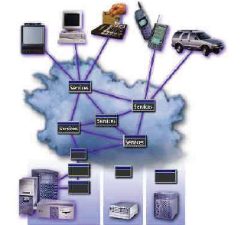
Why Web Services?

Slide 40
Why Web Services?
Web Services:
  Are platform neutral
  Are accessible in a standard way
  Are accessible in an interoperable way
  Use simple and ubiquitous plumbing
  Are relatively cheap
  Simplify enterprise integration
  Interoperable – Connect across heterogeneous networks using ubiquitous web-based standards

Slide 41

Why Web Services?
  Economical – Recycle components, no installation and tight integration of software
  Automatic – No human intervention required even for highly complex transactions
  Accessible – Legacy assets & internal apps are exposed and accessible on the web
    Available – Services on any device, anywhere, anytime
    Scalable – No limits on scope of applications and amount of heterogeneous applications

Slide 42
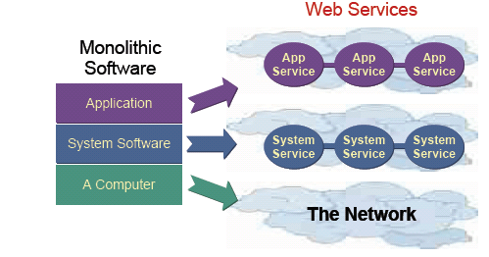
Impact of Web Services on Software:“Application Dis-Integration”

Slide 43
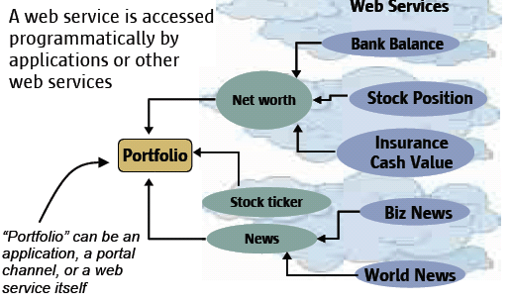
Macro web services – Virtual Systems

Slide 44
Three Laws of Computing
Moore's Law
– Computing power doubles every 18 months
Gilder's Law
– Network bandwidth capacity doubles every 12 months
Metcalfe's Law (Net Effect)
– Value of network increases exponentially as
number of participants increases

Slide 45
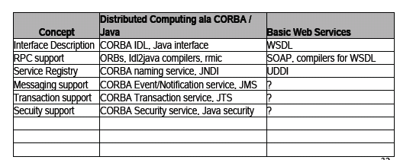
Web Services is a New Concept?
Web services is distributed computing all over again – only now it is based on the web

Slide 46
What is Web Services?

Slide 47
What is Web Services?
Web Services Definition by W3C
A Web service is a software application
identified by a URI,
whose interfaces and binding are capable of being defined, described and discovered by XML artifacts and
supports direct interactions with other software applications
using XML based messages
via internet-based protocols

Slide 48
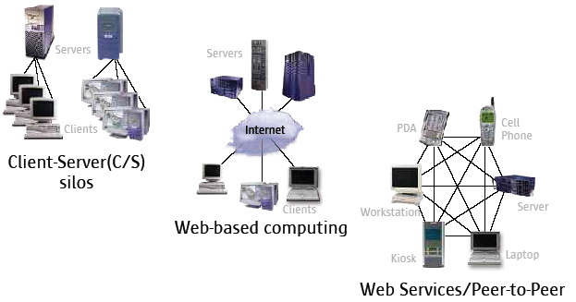
Distributed Computing Evolution

Slide 49
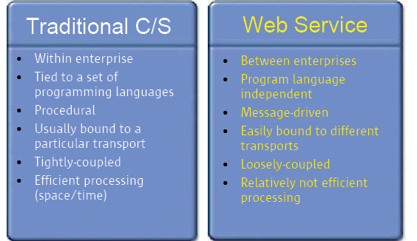
Distributed Computing Evolution
Traditional C/S vs. Web Services

Slide 50
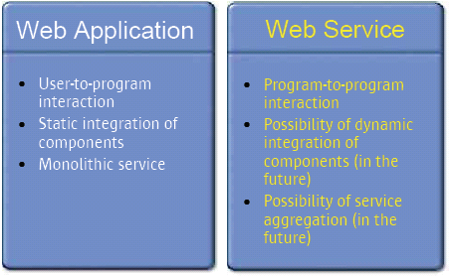
Distributed Computing Evolution
Web Application vs. Web Services

Slide 51
Characteristics of Web Services
XML based everywhere
  Message-based
  Programming language independent
  Could be dynamically located
  Could be dynamically assembled or aggregated
  Accessed over the internet
  Loosely coupled
  Based on industry standards

Slide 52
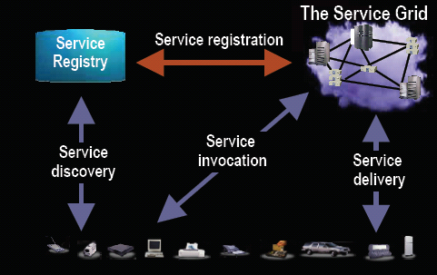
Web Services

Slide 53
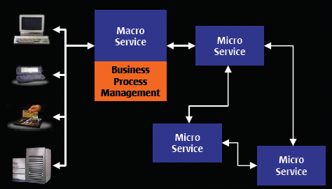
Service Assembly

Slide 54
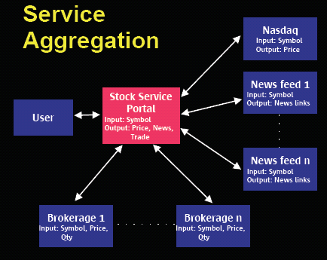
Service Aggregation

Slide 55
B2B with web service
languages and protocols standardized, eliminating need for many different middleware infrastructures (need only the Web services middleware)
customer
Web service
supplier
Web service
internal procurement
requests
internal infrastructure
internal infrastructure
interactions based on protocols redesigned for peer to peer and B2B settings
Web service
internal functionality made available as a service
internal infrastructure
warehouse

Slide 56
Web services also provide entry points for accessing local services
Web service
Web service
client
Web service
wide area network (Internet)
middleware
middleware
internal service
internal service
internal service
internal service
Company A (provider)
Company B (client)

Slide 57


Web service – an enterprise example
integrating application (contains the composition logic)
Web service-enabled broker
sendmail application
SmartQuotation
DBMS applications
SmartForecasting
Benefit:
heterogeneity reduction and P2P interaction

Slide 58
Middleware vs. web service
  Notice
  The notion of service in the conventional middleware is now translated into the notion of Web service based on the access channel to that service
  Changes
  The only thing that changes from the middleware and EAI is that a few details need to be changed so that they match the needs of exchanges through the Internet rather than a LAN - standardization:
    XML as the data representation format
    SOAP as a protocol wrapper to allow conventional communication protocols of middleware platforms to cross the Internet and firewalls (essentially turns invocations into document exchanges)
    WSDL as the XML version of IDLs (plus a few other things)
    UDDI as the WWW version of basic name and directory services

Slide 59
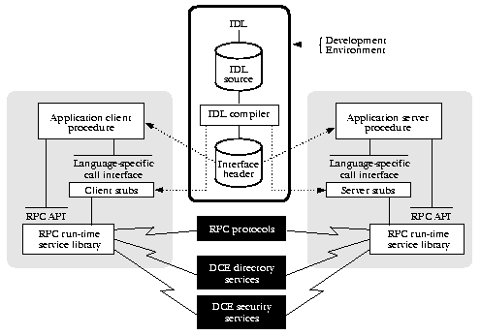
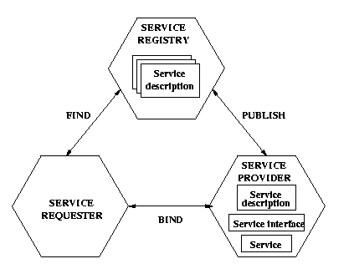
Middleware vs. Web services
WEB SERVICES WORD
MIDDLEWARE WORLD
UDDI
SOAP
WSDL

Slide 60
OO vs. web service
Are they similar?
  Modularization ?
  Reusability?
  Encapsulation?
What are the differences?

Slide 61
Where is Web Services going?

Slide 62
State of Web Services
Technology/Standards are still evolving
– SOAP, WSDL, UDDI are not enough
Business web services is the next big thing, but more works are needed in
  – Quality of Service, management
  – Security, transaction, state and user context
  – Work flow, Identity management,
  – Provisioning, Accounting
● Will be adopted in phases

Slide 63
Business Web Services (B2B)
Architectural Components (ebXML)
B2B collaboration
Secure and reliable message delivery
Non-repudiation
Partner profile
Repository for business data objects

Slide 64
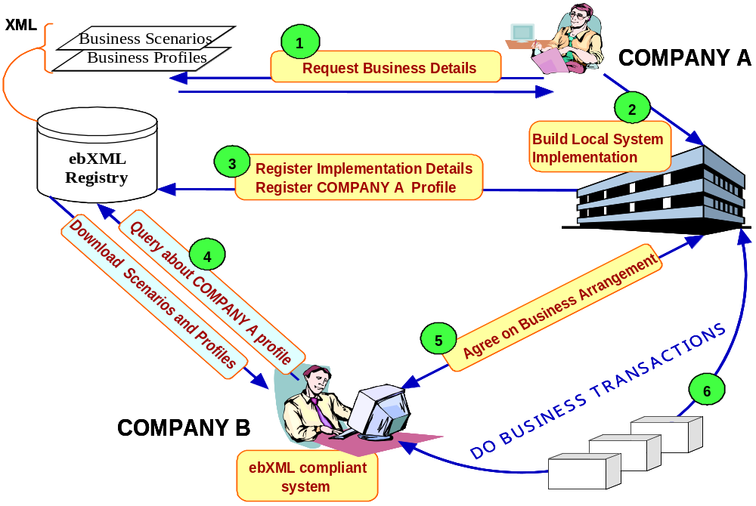
ebXML architecture – high level use case

Slide 65
Trends Towards Service Orientation
Evolution of EAI to web service standards
XML RPC => Asynchronous XML Messaging
Towards de-centralization
Componentized services
  – Composable and composite services
  – Data encapsulated within component
  – Data ownership follows component ownership
Brokered web services
Flexible relationships => Adaptive businesses

Slide 66
Web Services Architecture?

Slide 67
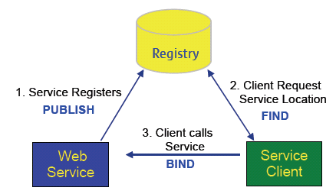
(Simplified) Web Service Architecture

Slide 68
Constructing Software In a Connected World
From Components to Services

Slide 69
Constructing software in the web era
(J2EE, .Net, …)
View
Client
Internet
request
response
b2b
App Server
EAI
Controller
ERP
CCI
CCI
CCI
Model
DB
ERP
CRM
CCI: Client Communication Interface

Slide 70
A Component now Becomes a Service Running Outside the Consumer Boundaries
Consumer
Discover and/or Bind
2
3
invoke
Policies
Registry
XML
XML
XML
SOAP
SOAP
SOAP
1
CCI
CCI
CCI
register
DB
ERP
CRM
Service
Service
Service

Slide 71

From Components to (Web) Services
Requires a client library
Client / Server
Extendable
Stateless
Fast
Small to medium granularity
Loose coupling via
  Message exchanges
  Policies
Peer-to-peer
Composable
Context independent
Some overhead
Medium to coarse granularity

Slide 72
Web Services: what is changing?(1)
Loose coupling (of course)
  Web Services don’t require a CCI (Client side Communication Interface)
    Very few “gears” needed to consume a service
  Web Services can accept message content they do not fully understand or support
    XML, WSDL
  Web services are very late bound
    Location is independent of the invocation mechanism
    Directories

Slide 73


Web Services: What is Changing?(2)
Peer-to-peer interactions are possible
  Request / response is an inefficient and very limiting mode of interaction
  As components coarsen, it is difficult to differentiate a client from a server

Slide 74
What Happens to the Technical Services Typically Provided by an Application Server?
Transaction
Security
Connection pooling
Naming service
Scalability and failover
…
They become the “Service Fabric”

Slide 75
What about the notion of “Container”? They become Service “Domains”
The notion of “container” shifts to the notion of “Domain Controller”
  A domain is a collection of web services which share some commonalities like a “secure domain”
  A container is a domain with one web service
  Web Services do not always need a container
Consumers invoke the domain rather than the service directly
This concept does not exist in any specification…

Slide 76
A Service Fabric can be more than a Bus with a series of Containers / Adapters
Consumer
Discover and/or Bind
Policies
Registry
Tx
XML
Reliable
Messaging
XML
XML
Registry
Domain
Controller
Process
CCI
CCI
CCI
register
DB
ERP
CRM
NEP
NEP
NEP

Slide 77
Web Services Standards

Slide 78
Core Web Services Standards
SOAP (Simple Object Access Protocol)
WSDL (Web Service Definition Language)
UDDI (Universal Description, Discovery and Integration)

Slide 79

ebXML
A global electronic market place where
enterprises of any size, anywhere can:
– Find each other electronically
– Conduct business through exchange of XML based business messages

Slide 80
More Web Services Standards
Security
– XML Signature, XML Encryption, XKMS, XACML, SAML, Liberty, WS-Security
Transaction
– BTP, WS-Transaction
Business collaboration and choreography
– ebXML BPSS, ebXML CPP/CPA, BPML, WSFL, XLANG, WSCI, BPEL4WS

